Slide 1
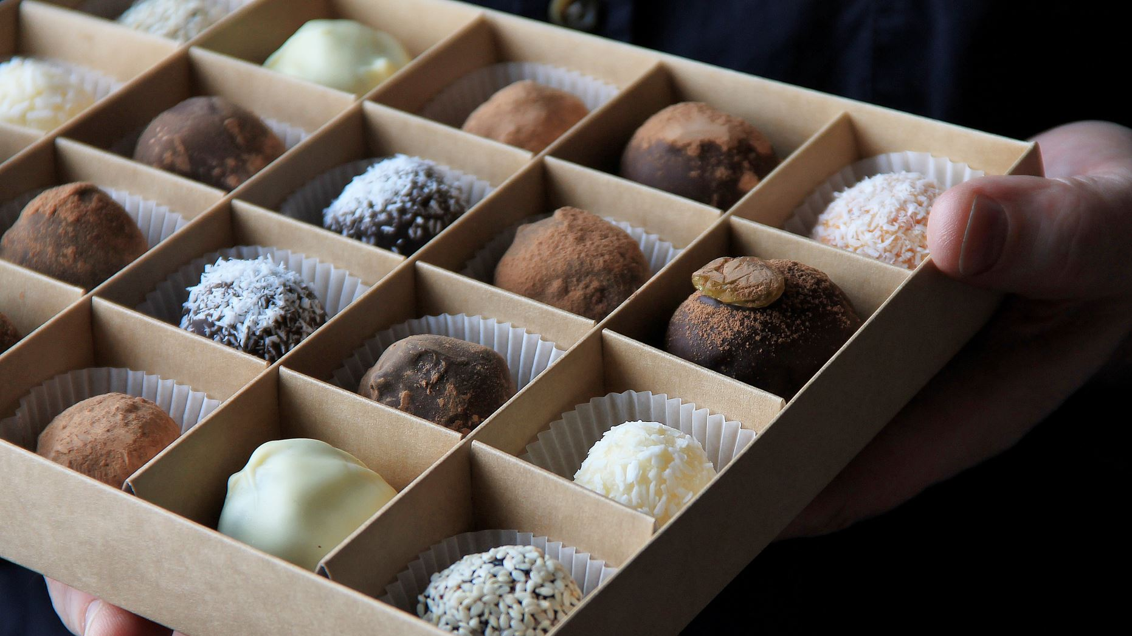
Chocolate sales analysis for 2023

Slide 2







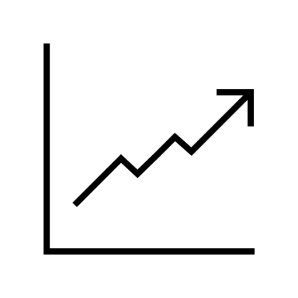
2023 kip’s
Total Sales
$203,538,699
Total Orders
315
Products we offer
22
Salespersons
10
Selling Regions
6
Average Selling Units
152
Average Products Amount
4,210
Highest Selling Quarter
(Q1 $65,865,534)

Slide 3
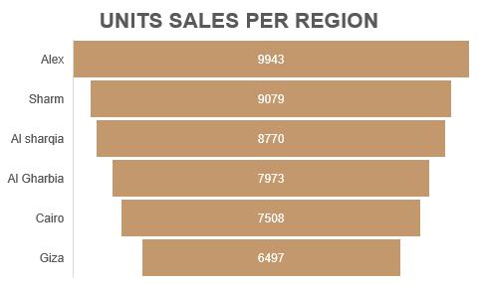
Regions Analysis
Sharm and Al Sharqia each account for nearly 50% of sales per region, with approximately 90 million in total sales per region.
Al Sharqia had the highest unit sales, while Sharm has lower unit sales but generated higher total sales.
Giza had the lowest sales, and the fewest units sold.
Alex, Cairo, and Gharbia had similar sales figures and unit volume.

Slide 4
Products Analysis
The best-selling product were caramel stuffed bars, Maked high Revenue
The 70% Dark Bites and Smooth Silky Salty had high demand and from TOP-5 selling products
Choco Coated Almonds sold fewest units but had high selling revenues

Slide 5
Monthly Review
January generated the highest revenue and sales, despite having the fewest orders.
Sales and orders were typically at their lowest in November.
October had the highest number of orders but not the highest revenue.
Sales declined gradually over four quarters, while order volume increased steadily.

Slide 6
Salespersons performance
Hassan Ahmed had the highest number of orders but a lower ranking in total sales.
Sara Khaled led the highest sales with $24.6M, despite not having the highest number of orders.
Hassan Ahmed recorded highest number of orders but less ranking in total sales
Ahmed Said and Abdel Rahman Mohamed both had lower total sales and fewer orders.

Slide 7
Recommendations

